Slide 1

St. Ann’s College of Engineering & Technology Department of CSE- AI&ML A Project Review on
Roadsy: Automated Traffic Sign Detection and Classification
Presented By:
CH. Paul Adarsh-2OFO1A4213
D. Shanmukha Sai-20F01A4216
Under the Guidance of M. Nikhil-20F01A4237
Mrs.M Sarada N. Ravi Teja-20F01A4239
R. Sai Gopi-20F01A4248

Slide 2
CONTENTS
Abstract
Introduction
Model Architecture
Implementation
Design Steps
Result
Conclusion
Future Extension

Slide 3
ABSTRACT
Traffic sign detection and classification is an important feature of advanced driver assistance systems, contributing to driver and autonomous cars safety as well as increasing driving comfort.
In today's world, road conditions have improved significantly compared to previous decades.
Our model helps drivers recognize road signs to avoid road accidents, while also providing warnings to drivers and advanced driver assistance systems.
Use a convolutional neural network (CNN) model to detect traffic signs in real-time training data.

Slide 4
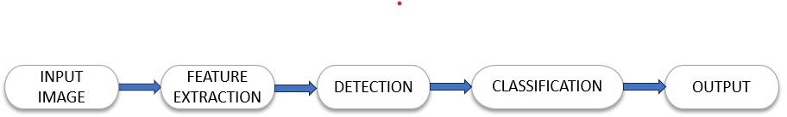
INTRODUCTION
Traffic Sign Detection and classification system is an intelligent computer vision system that makes the use of artificial intelligence to identify and detect the traffic signs.
2. System captures the image from the vehicle in motion to uniquely identify the traffic sign by just discarding the unnecessary data in the image and focuses on retrieving traffic sign.

Slide 5

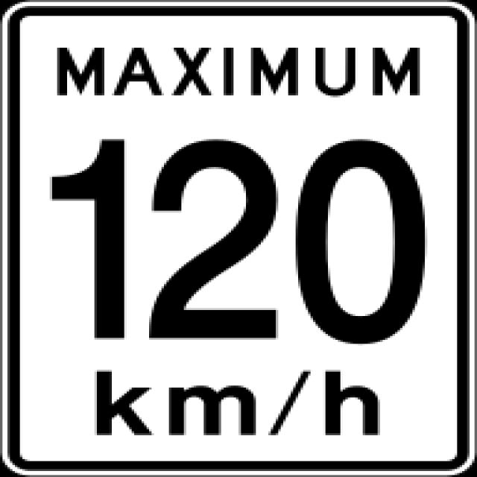
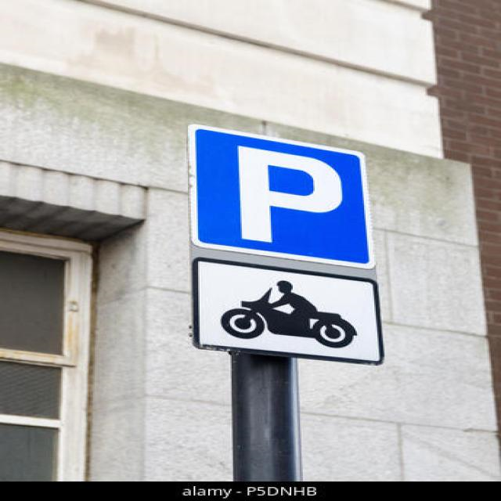
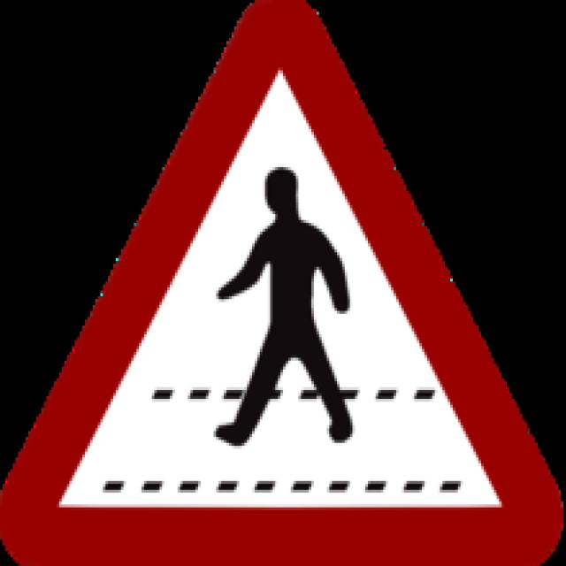
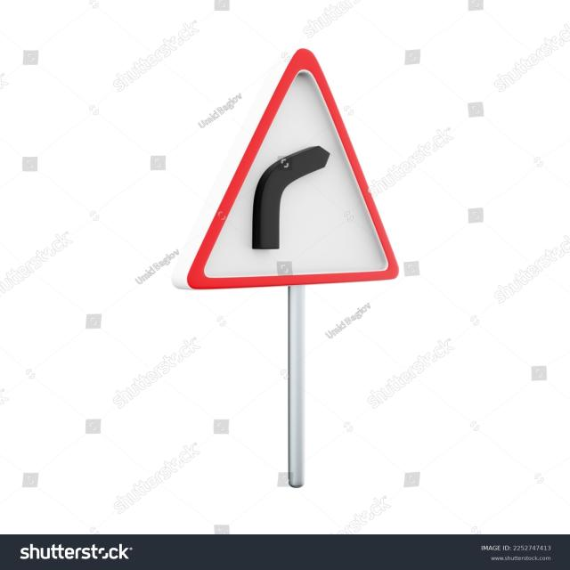
EXAMPLES

Slide 6
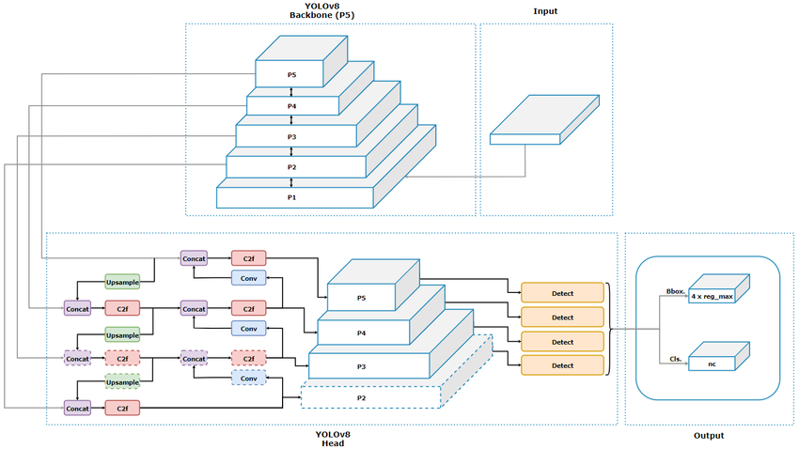
MODEL ARCHITECTURE
YOLO V8:

Slide 7
YOLO stands for YOU ONLY LOOK ONCE.
YOLOv8 is a deep learning model.
YOLOv8 is a state-of-the-art deep learning model used for real-time object detection in computer vision applications.
YOLOv8 offers the ability to use both pre-trained models and custom models.
It supports data preparation for training custom models and enables the creation of web applications for real-time object detection in the web browser.

Slide 8
YOLOv8 incorporates multiple object detection methods, including classification, object detection, and image segmentation. These methods allow for the identification, localization, and precise boundary detection of objects in images.
YOLOv8 is widely used in industries such as robotics, autonomous driving, and video surveillance.

Slide 9
IMPLEMENTATION
We implement this project with the help “alabama-transport-institute” dataset which is available in roboflow.
This dataset contain 4148 images.
2565 images is used for training.
770 images is used for validation.
813 images is used for testing.

Slide 10
DESIGN STEPS
Data collection
Data Preprocessing
Building the model
Model Training
Model Evaluation
Deployment
Testing

Slide 11
RESULT
We run this project with giving epochs as 100 and batch size as 640.
By getting the mAp(Mean Average Precision) as 85%, Precision as 81.3% and recall as 81%.
mAp is a metric used to evaluate object detection.
Precision measures the percentage of predictions made by the model that are correct.
Recall measures the percentage of relevant data points that were correctly identified by the model.

Slide 12
Conclusion:
The proposed model aims to advance Advanced Driver Assistance Systems (ADAS) towards autonomous cars. It relies on CNN model for efficient sign detection based on color and shape, facing challenges like reflections impacting color and improper sign shapes. Night detection is an issue, especially with non-infrared webcams. To enhance safety, an AI Assistant is suggested to help drivers concentrate on driving instead of constantly checking traffic signs, reducing accidents both day and night.

Slide 13
FUTURE EXTENSION
When we enter a destination into our vehicle's navigation system, it shows us a route map with all the traffic signs along the way. If we're driving fast, the advanced camera system in the vehicle helps detect upcoming traffic signs early and displays them. If we're driving against a traffic sign, the vehicle either slows down or continues normally.

Slide 14
THANK YOU

